Slide 1
BUILDERS CAMP HACKATHON
Team Members: Ramanathan R
Mohd Nauman
Ajit J Gupta

Slide 2
PROBLEM STATEMENT (Customer Segmentation)
The problem addressed is the growing need for businesses to analyze customer data to enhance their experience and loyalty, and create personalized marketing. Customers expect individualized experiences, which requires a unified view of the customer and the ability to personalize experiences across various touchpoints. AI and ML techniques can help generate an understanding of different customer types and patterns within an ecosystem

Slide 3
Objective
Segment customers based on their RFV(Recency, Frequency, Value) attributes.
Purpose
1. Target Promotions
2. Demand Forecasting and Plan for Inventory

Slide 4
Data (AI Reference kit Customer Segmentation)
Sales data for the Year 2011
About 400K line items
About 4K Customers
Assumptions
The Dec 31st 2011 is the current Date

Slide 5
Data Wrangling
Removed records with Negative Quantity
Removed records with Zero Price
Removed records pertaining Bank/Postages
Retained only UK Records
Removed outliers w.r.t number of trips/bills

Slide 6
Algorithm
Hierarchical Clustering
Why?
Less than 5K records and Hierarchical is exhaustive(nothing random about it) compared to K-Means or other techniques

Slide 7
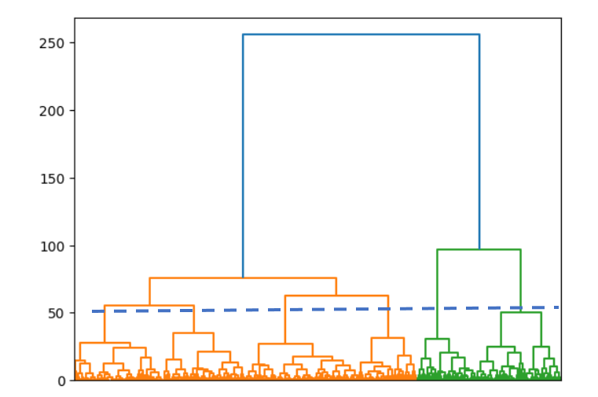
Dendogram

Slide 8
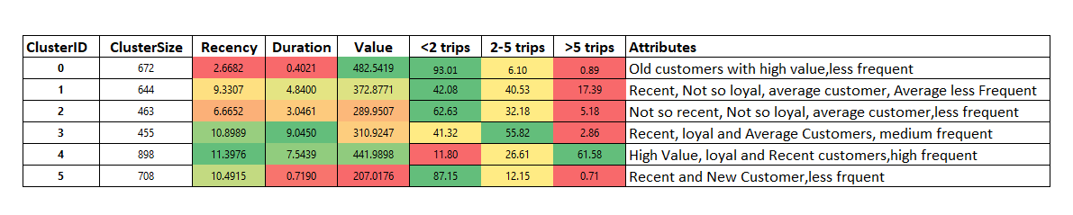
Cluster Metrics

Slide 9
Further Scope
Group products into various buckets and profile (similar to number of trips)
Github Link : https://github.com/ajitg25/BuilderCamp

